Slide 1

Asset Creation
By Humberto Carolino

Slide 2
Assets Made
Character
Target
Wall
Floor Tile
Knife
Crate
Door
Different Kinds of rocks

Slide 3
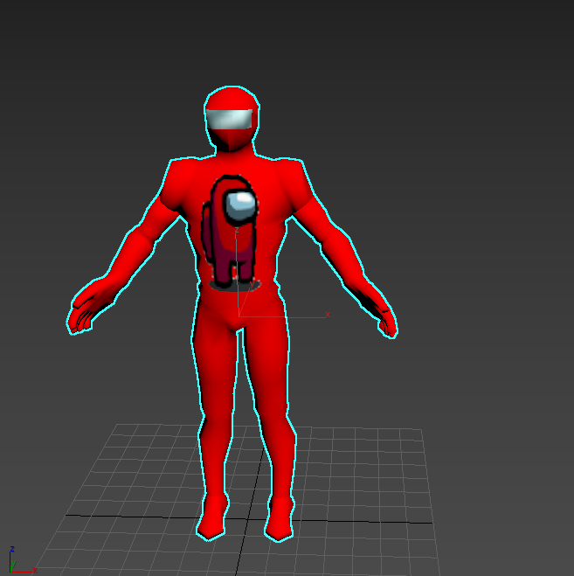
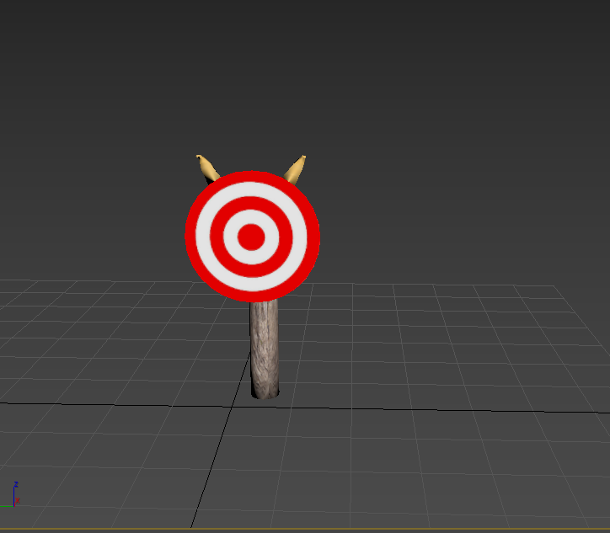
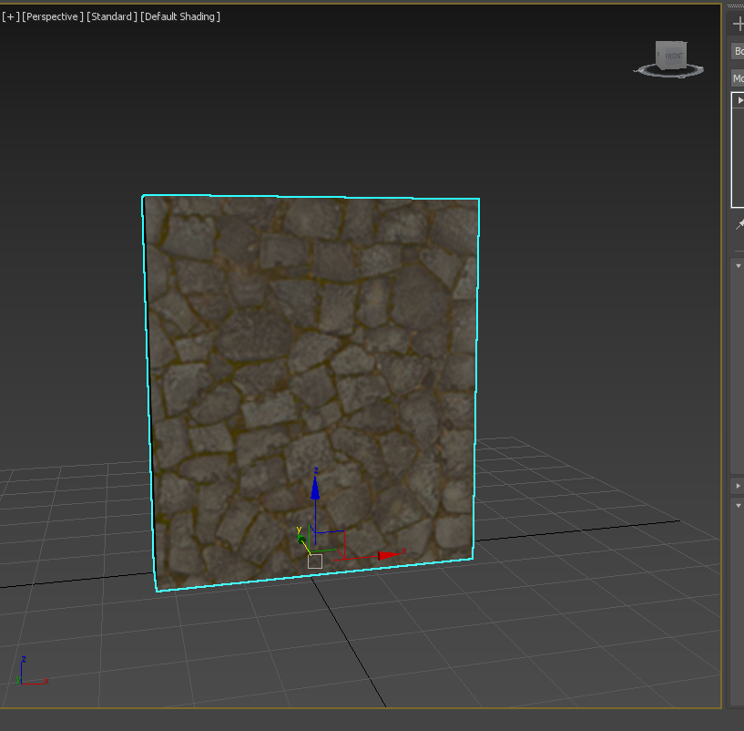
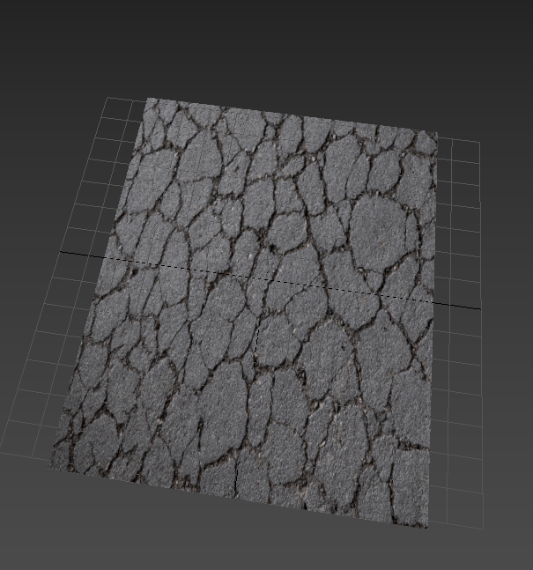
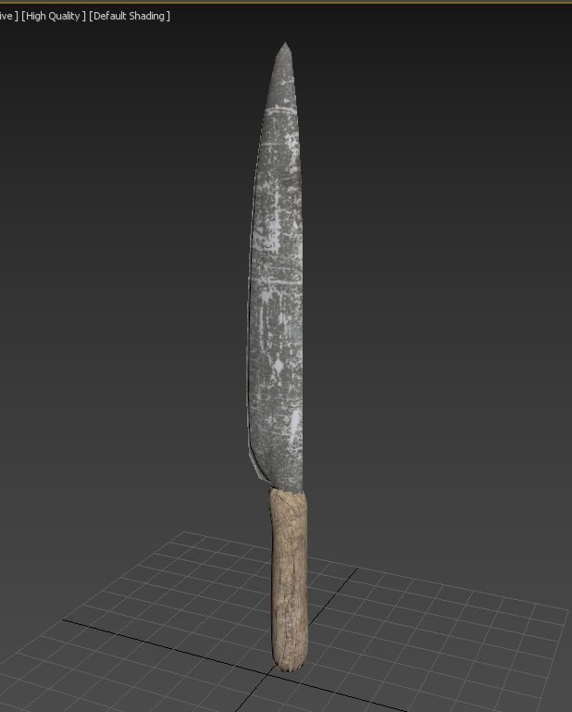
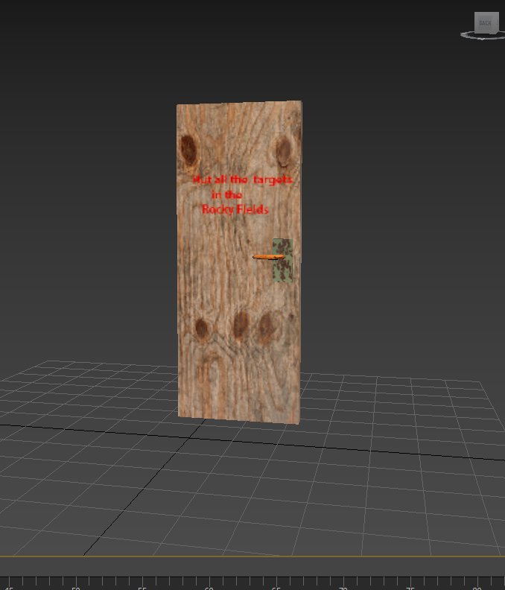
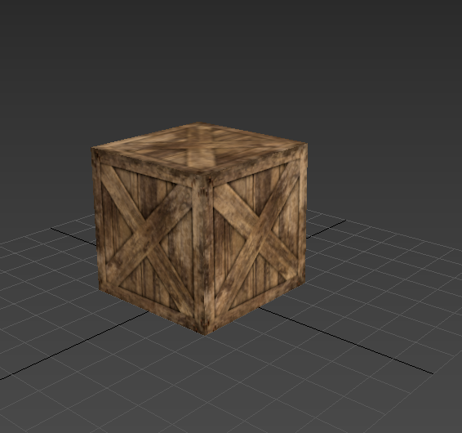
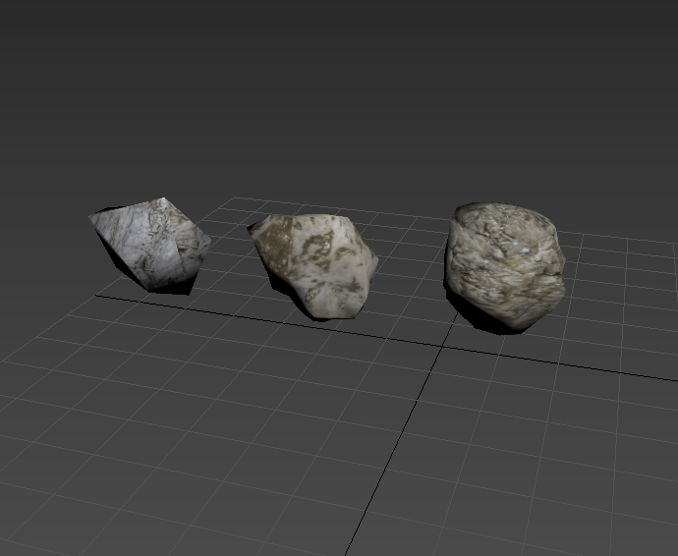
Images for Proof of the objects made

Slide 4
Modifiers and tools used to make Each object
Unwrap UVW ( On almost every object)
TurboSmooth (Knife)
Bend (Door)
TargetWeld( Human body)
Boolean (Door)
Attach(Target)
Material Texture( on every Object)
Displace (Rocks)
Extrude (Knife, Body and target)
Standard primitives( most of the objects
Splines (Target, knife and body)

Slide 5
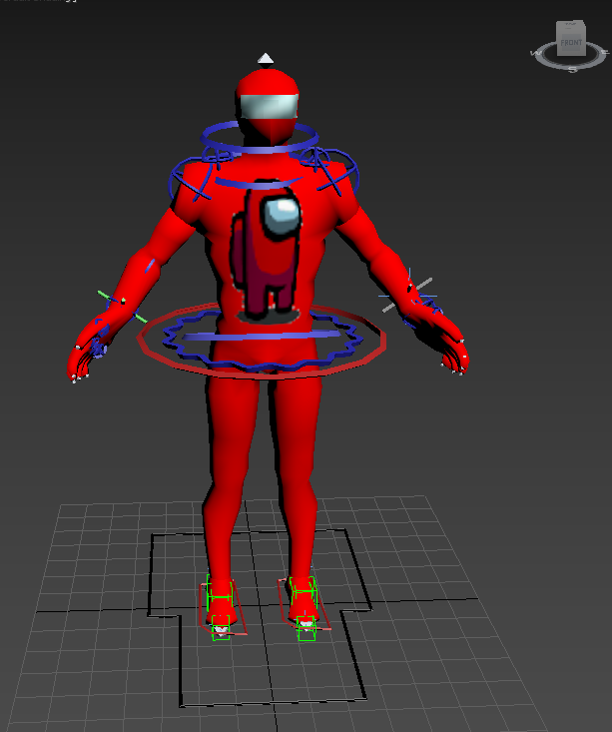
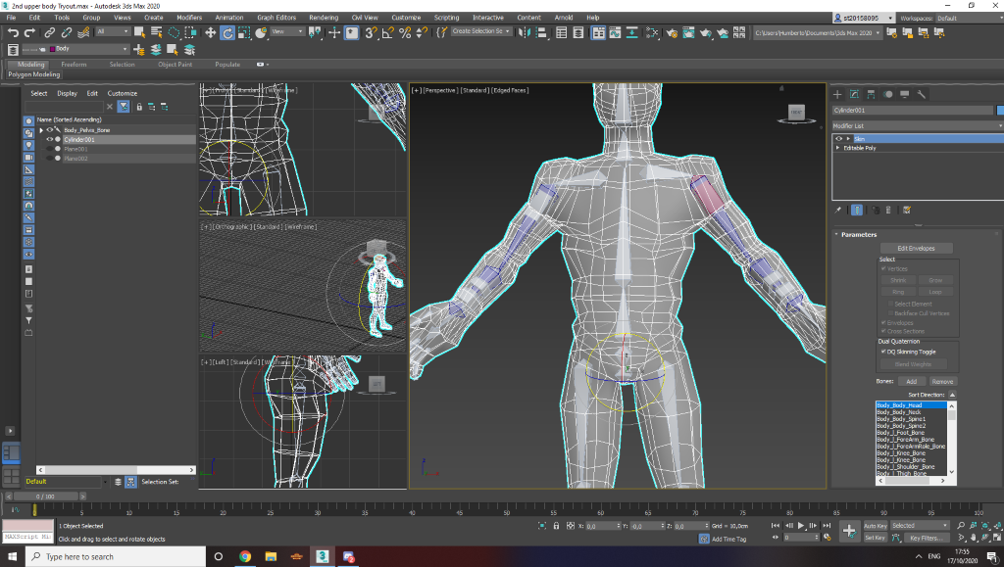
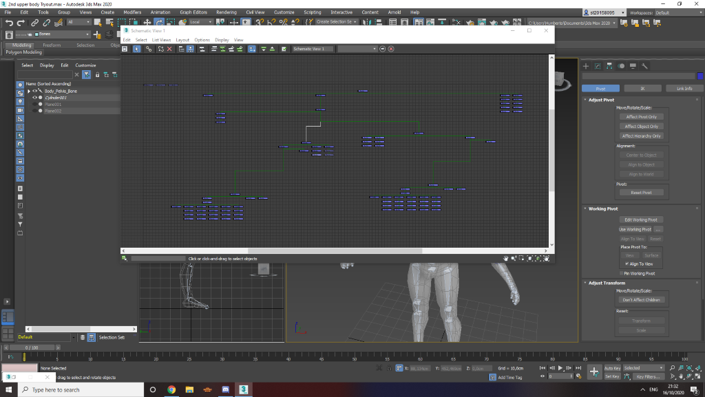
Skinning applied to the body with also an extra controllers to control the body

Slide 6
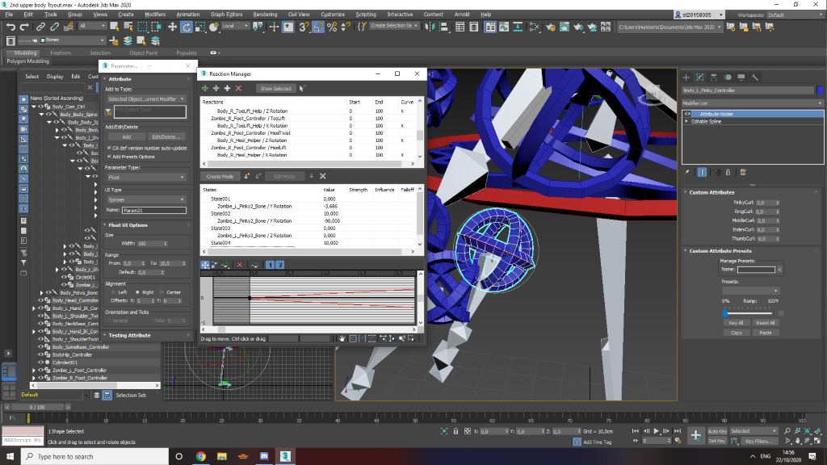
What the controllers and bones contain
Attribute Holders
Linking
Orientation constraints
Position Constraints
IK Solvers
Link info ( used locks)
Helpers

Slide 7
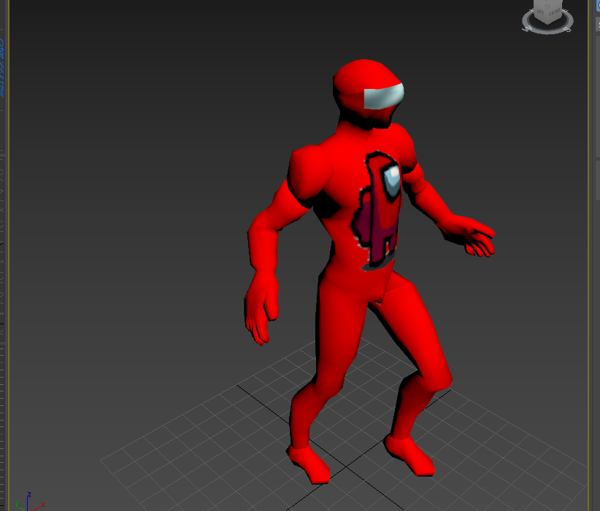
Animation
There will be a video attached in the folder to showcase the animation

Slide 8
Sound effects used (all the sound effects were made by myself)
Wind Blowing
Knife going agaisnt wood
Walking

Slide 9
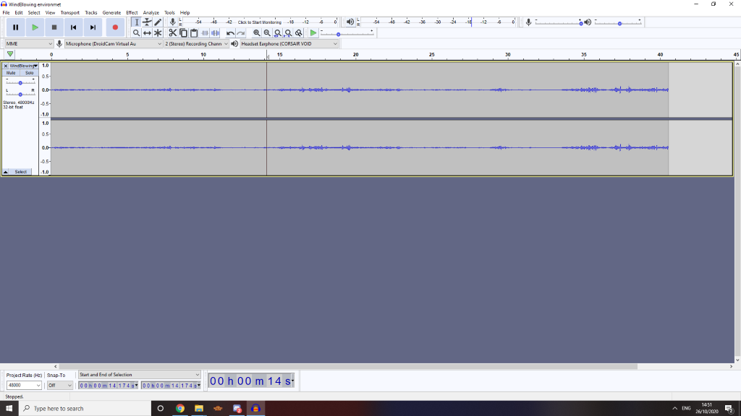
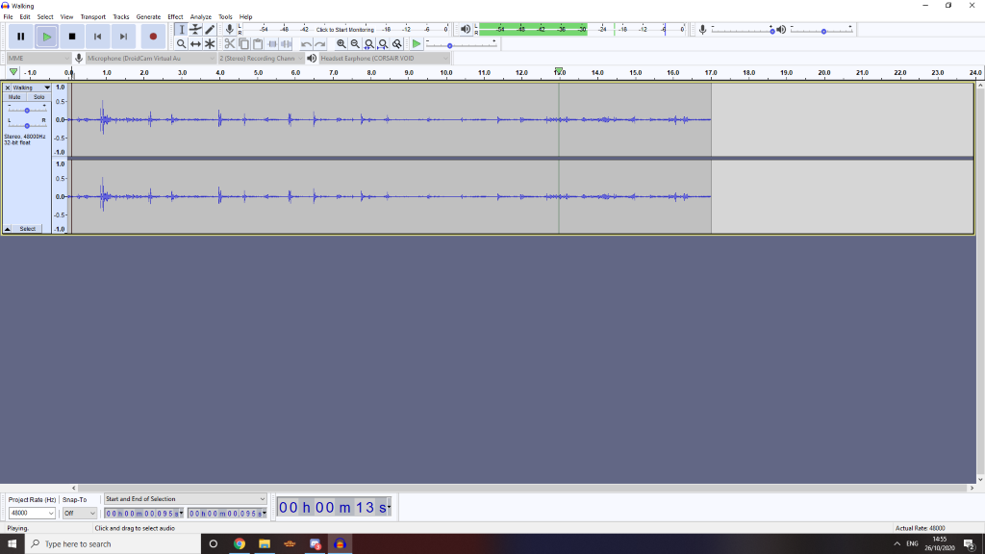
Editing applied to the sound effects

Slide 10
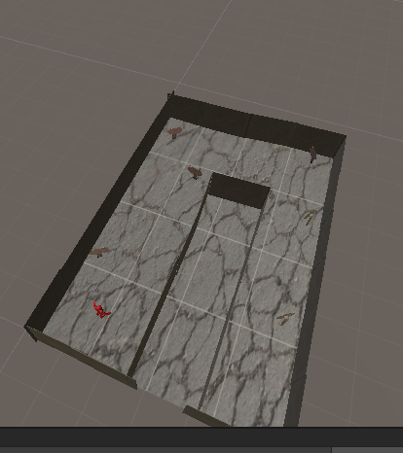
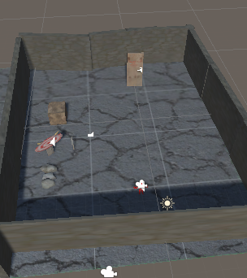
Levels 1 and 2 made using the assets

Slide 11
References to the textures used.
https://www.textures.com/

